Slide 1
Lecture 14
Descriptive Statistics
Statistical Inference

Slide 2
Data: 2009/2010 Survey of peasant workers in Beijing
Education | Number of Household Members | Insurance | Contract | Monthly Household Income | Monthly Household Consumption
教育 | 家庭 人口数 | 社会保险 | 用工 合同 | 家庭月收入 | 家庭月消费
2 | 2 | 0 | 0 | 89000 | 300
2 | 4 | 0 | 0 | 35000 | 400
1 | 5 | 0 | 0 | 3200 | 50
3 | 3 | 0 | 0 | 21000 | 350
1 | 4 | 0 | 0 | 40000 | 750
3 | 3 | 0 | 0 | 1500 | 30
4 | 4 | 0 | 0 | 34000 | 1000
3 | 6 | 0 | 1 | 4600 | 200
... | ... | ... | ... | ... | ...
an observation
Education (教育): 0=no education (未受教育), 1=primary school (小学),
  2=middle school (初中), 3=high school (高中),
4=junior college (专科), 5=college (本科)
Notes:
dfghdfghfdghgfhdfghdfgh

Slide 3
Basic Concepts
Population (总体) & Sample (样本)
  Population: the set of all units of interest in a particular study.
  Sample: a subset of the population.
Sample:
1419 peasant workers in Beijing
being surveyed
Population:
all peasant workers in Beijing
Notes:
dfghdfghfdghgfhdfghdfgh

Slide 4
Descriptive Statistics
To show and describe the information of data on the sample by using values, forms or charts.
Notes:
dfghdfghfdghgfhdfghdfgh

Slide 5
Sample Mean (Average Value, 均值)
Variable | Mean
Monthly Household Income | 3950
Monthly Household Consumption | 1484
What do you discover?

Slide 6
Summary of Monthly Household Income
Income | Frequency | Percentage
(0,1250] | 229 | 16.14%
(1250,2500] | 515 | 36.29%
(2500,3750] | 229 | 16.14%
(3750,5000] | 192 | 13.53%
… | … | …
(88750,90000] | 1 | 0.07%
Total | 1419 | 100.00%

Slide 7
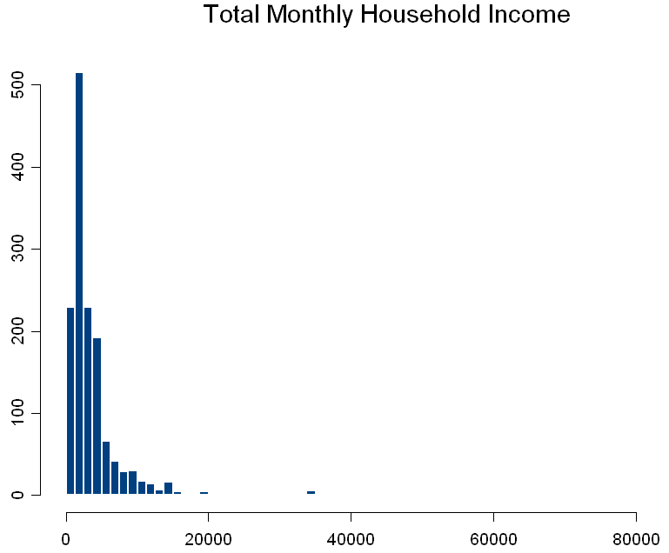
Visual Inspection: Histogram (直方图)

Slide 8
Key Findings & Actions
Key Findings:
  Mean is a simple measure for “location”.
  It is very sensitive to outliers.
  There might be other way to measure “location”.
  Variability is the missing key!
Actions:
  Are there other ways to measure location?
  How to measure variability?

Slide 9
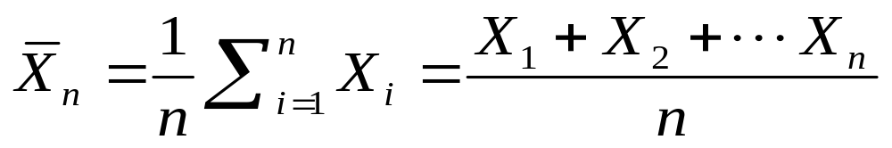
Location: Sample Mean
The average value for a variable:
The most common measure of central location.
It can be influenced by extreme values.
0 1 2 3 4 5 6 7 8 9 10
0 1 2 3 4 5 6 7 8 9 10 12 14
mean = 5
mean = 6
Notes:
dfghdfghfdghgfhdfghdfgh

Slide 10
Location: Sample Median (中位数)
Important measure of central location.
When the data are arranged in ascending order (smallest value to largest value):
  If n is odd, the median is the middle value.
  If n is even, the median is the average of the two middle values.
It is not influenced by extreme values.
0 1 2 3 4 5 6 7 8 9 10
0 1 2 3 4 5 6 7 8 9 10 12 14
median= 5
median= 5
Notes:
dfghdfghfdghgfhdfghdfgh

Slide 11
Location: Sample Median
Variable | Mean | Median
Monthly Household Income | 3950 | 2500
Monthly Household Consumption | 1484 | 1000
What do you discover?

Slide 12
Location: Sample Percentile (百分位数)
The p th percentile：
  at least p percent of the observations are less than or equal to this value,
  and at least (100-p) percent of the observations are greater than or equal to this value.
Notes:
dfghdfghfdghgfhdfghdfgh

Slide 13
Location: Sample Percentile
Calculation of the p th percentile:
  Arrange the data in ascending order (smallest value to largest value).
  Compute i=(p/100)n.
  (a) If i is not an integer, the next integer greater than i denotes the position of the p th percentile.
  (b) If i is an integer, the p th percentile is the average of the values in positions i and i+1.
Notes:
dfghdfghfdghgfhdfghdfgh

Slide 14
Example of Sample Percentile
Suppose a peasant worker in Beijing had a monthly household income of RMB 5000.
How he performed in relation to other peasant workers may not be readily apparent.
However, if the income corresponded to the 80th percentile, we know that 80% of peasant workers in Beijing had lower income than this individual and 20% of peasant workers in Beijing had higher income than this individual.

Slide 15
Location: Sample Quartile (四分位数)
Divide the ordered data into four parts, with each part containing approximately one-fourth, or 25% of the observations.
25%
25%
25%
25%
Q₁
Q₂
Q₃
11 12 13 16 16 17 18 21
Q₁
=12.5
Q₃
=?
Notes:
dfghdfghfdghgfhdfghdfgh

Slide 16
Location: Sample Quartile
Variable | Mean | Q1 | Median | Q3
Monthly Household Income | 3950 | 1500 | 2500 | 4500
Monthly Household Consumption | 1484 | 600 | 1000 | 2000
What do you discover?

Slide 17
Variability: Sample Range (全距)
range= largest value – smallest value
It ignores the distribution of the data
It is highly influenced by extreme values
range= 12 - 7 = 5
range= 12 - 7 = 5
7 8 9 10 11 12
7 8 9 10 11 12
Notes:
dfghdfghfdghgfhdfghdfgh

Slide 18
Variability: Sample Inter-quartile Range
(IQR,四分位距)
IQR=Q₃-Q₁
the range for the middle 50% of the data
Notes:
dfghdfghfdghgfhdfghdfgh

Slide 19
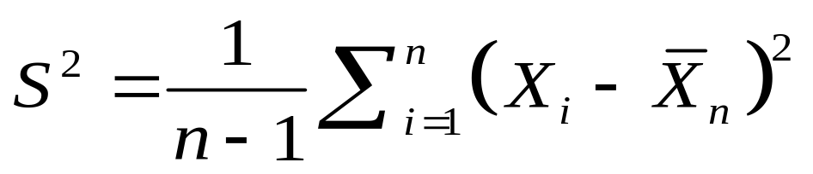
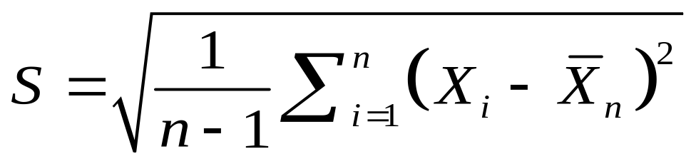
Variability: Sample Variance (方差) & Sample Standard Deviation (标准偏差)
Most popular measure
  Sample Variance
  Sample Standard Deviation (SD)
Notes:
dfghdfghfdghgfhdfghdfgh

Slide 20
Comparing Standard Deviations
Data A
Mean = 15.5
s = 3.338
11 12 13 14 15 16 17 18 19 20 21
Data B
Mean = 15.5
s = .9258
11 12 13 14 15 16 17 18 19 20 21
Data C
Mean = 15.5
s = 4.57
11 12 13 14 15 16 17 18 19 20 21
Notes:
dfghdfghfdghgfhdfghdfgh

Slide 21
Variability
Variable | Mean | Q1 | Median | Q3 | Range | IQR | Variance | SD
Monthly Household Income | 3950 | 1500 | 2500 | 4500 | 88640 | 3000 | 27929203 | 5285
Monthly Household Consumption | 1484 | 600 | 1000 | 2000 | 19970 | 1400 | 2254684 | 1502
What do you discover?

Slide 22
Benefit of Using The Standard Deviation
Rather Than The Variance
The standard deviation is measured in the same units as the original data. So the standard deviation is more easily compared to the mean and other quantities that are measured in the same units as the original data.
Notes:
dfghdfghfdghgfhdfghdfgh

Slide 23
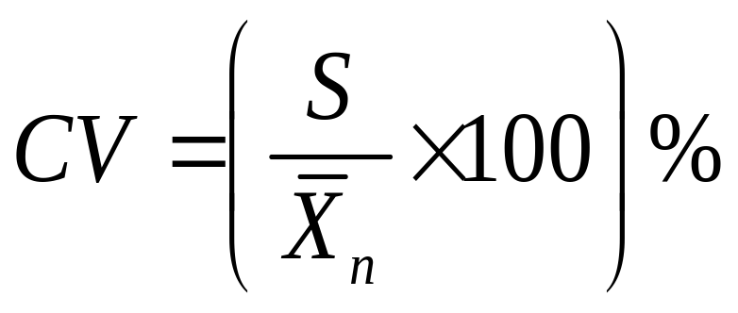
Sample Coefficient of Variation (变异系数)
Indicates how large the standard deviation is relative to the mean.
Can be used for the comparison between two or more sets of data.
Formula:
Notes:
dfghdfghfdghgfhdfghdfgh

Slide 24
Comparison
Stock A: average price of last year = $2.5
S.D. = $5
Stock B: average price of last year = $100
S.D. = $5
Coefficient of Variation
Stock A: 200%
Stock B: 5%
Notes:
dfghdfghfdghgfhdfghdfgh

Slide 25
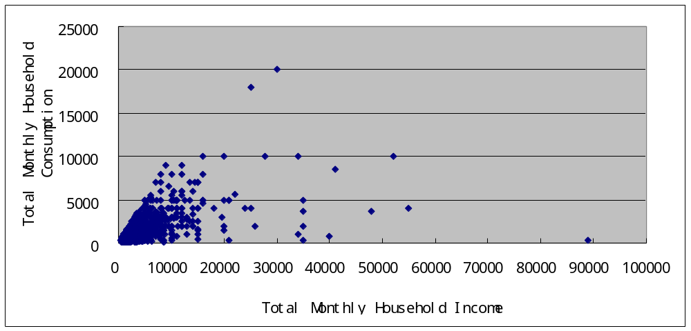
Scatter Diagram (散点图)

Slide 26
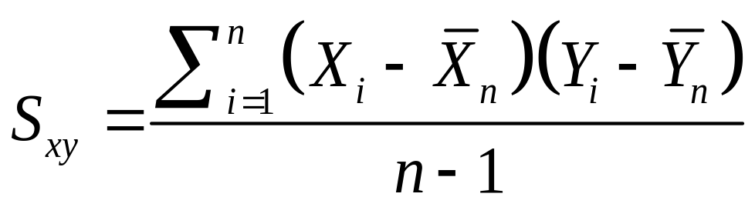
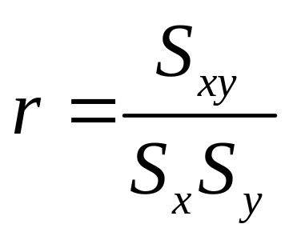
Sample Correlation Coefficient
The sample correlation coefficient is valued between：[-1, 1].
.
Notes:
dfghdfghfdghgfhdfghdfgh

Slide 27
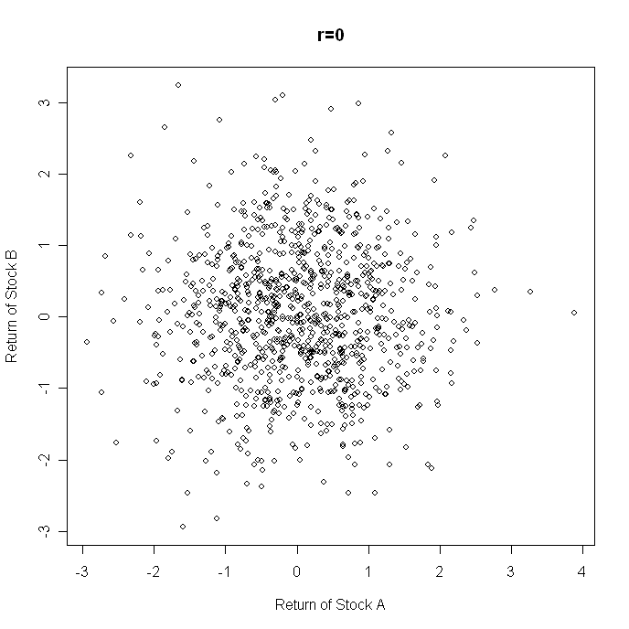

Slide 28
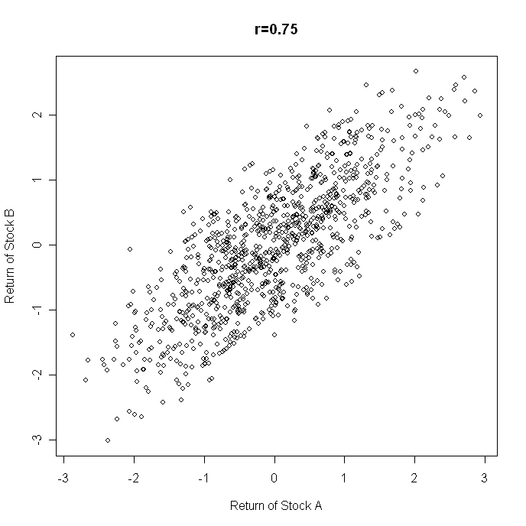

Slide 29
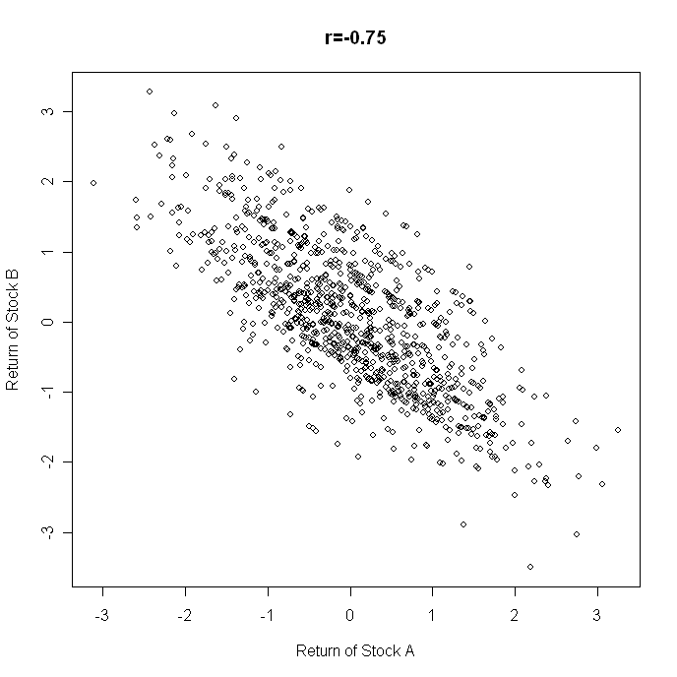

Slide 30
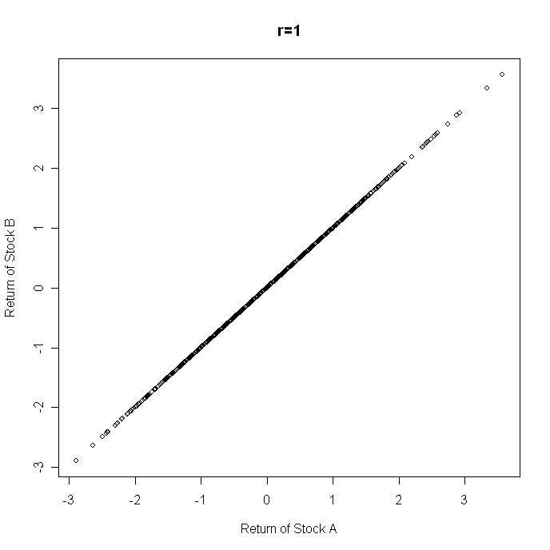

Slide 31
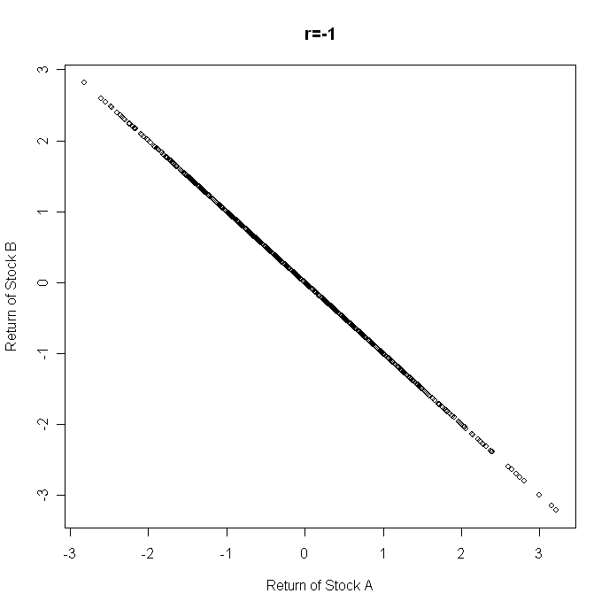

Slide 32
Qualitative Variables (定性变量)
Quantitative Variable: observations measured on a naturally occurring numerical scale.
Qualitative Variable: observations can only be classified into one of a group of categories.
  Qualitative Variables in the Example:
  Education
  Insurance
  Contract

Slide 33
E.g. The “Education” Variable
Education | frequency | relative frequency | percent frequency
0 | 33 | 0.023 | 2.3
1 | 144 | 0.102 | 10.2
2 | 647 | 0.457 | 45.7
3 | 445 | 0.314 | 31.4
4 | 111 | 0.078 | 7.8
5 | 36 | 0.025 | 2.5
Total | 1416 | 1 | 100
Notes:
dfghdfghfdghgfhdfghdfgh

Slide 34
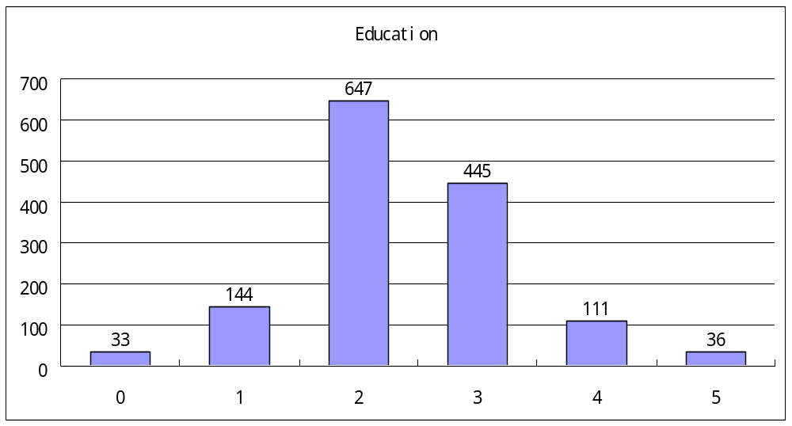
Bar Chart for the “Education” Variable

Slide 35
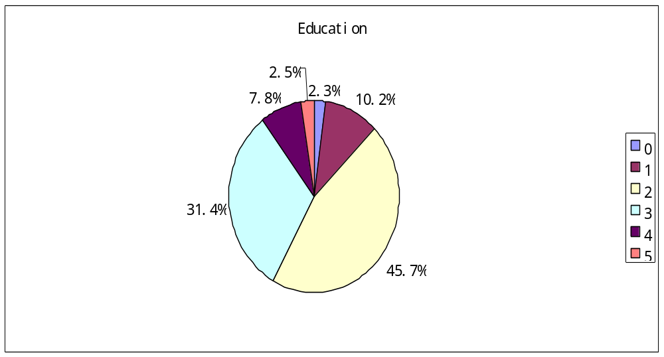
Pie Chart for the “Education” Variable

Slide 36
Cross-tabulation of “Education” and “Insurance”
Education | Insurance |  | Total
 | 0 | 1
0 | 27 | 6 | 33
1 | 119 | 25 | 144
2 | 495 | 152 | 647
3 | 324 | 121 | 445
4 | 58 | 53 | 111
5 | 13 | 23 | 36
Total | 1036 | 380 | 1416
Notes:
dfghdfghfdghgfhdfghdfgh

Slide 37
Cross-tabulation of “Education” and “Insurance”:
Row Percentages
Education | Insurance |  | Total
 | 0 | 1
0 | 81.8 | 18.2 | 100
1 | 82.6 | 17.4 | 100
2 | 76.5 | 23.5 | 100
3 | 72.8 | 27.2 | 100
4 | 52.3 | 47.7 | 100
5 | 36.1 | 63.9 | 100
What do you discover?
Notes:
dfghdfghfdghgfhdfghdfgh

Slide 38
Cross Education-level Comparison of Monthly Household Income
Education | Frequency | Mean | Q1 | Median | Q3 | Range | IQR | Variance | SD
0 | 33 | 3234 | 1800 | 2000 | 3300 | 12200 | 1500 | 7884743 | 2808
1 | 144 | 3391 | 1475 | 2075 | 3300 | 39300 | 1875 | 20426437 | 4520
2 | 647 | 3615 | 1500 | 2300 | 4000 | 88500 | 2500 | 29982727 | 5476
3 | 445 | 4239 | 1500 | 2700 | 5000 | 40640 | 3500 | 22176609 | 4709
4 | 111 | 5152 | 2000 | 3000 | 5500 | 54000 | 3500 | 49946923 | 7067
5 | 36 | 5551 | 2875 | 3750 | 6475 | 34000 | 3600 | 36664498 | 6055
What do you discover?

Slide 39
Classification of Statistics
Statistics
Descriptive Statistics
(描述统计)
Statistical Inference
(统计推断)
Tabular, graphical, or numerical summaries of data.
Addressing more advanced problems.
Notes:
dfghdfghfdghgfhdfghdfgh

Slide 40
Examples of More Advanced Problems
What is the profile of all peasant workers in Beijing?
  Distribution of education
  Mean number of household members
  Proportion of having social insurance
  Proportion of having employment contract
  Mean monthly household income
  Mean monthly household consumption
  …

Slide 41
Examples of More Advanced Problems
Education | Insurance |  | Total
 | 0 | 1
0 | 81.8 | 18.2 | 100
1 | 82.6 | 17.4 | 100
2 | 76.5 | 23.5 | 100
3 | 72.8 | 27.2 | 100
4 | 52.3 | 47.7 | 100
5 | 36.1 | 63.9 | 100
Do peasant workers in Beijing with different educational level have different proportion of having social insurance?
Notes:
dfghdfghfdghgfhdfghdfgh

Slide 42
Examples of More Advanced Problems
Education | Frequency | Mean | Q1 | Median | Q3 | Range | IQR | Variance | SD
0 | 33 | 3234 | 1800 | 2000 | 3300 | 12200 | 1500 | 7884743 | 2808
1 | 144 | 3391 | 1475 | 2075 | 3300 | 39300 | 1875 | 20426437 | 4520
2 | 647 | 3615 | 1500 | 2300 | 4000 | 88500 | 2500 | 29982727 | 5476
3 | 445 | 4239 | 1500 | 2700 | 5000 | 40640 | 3500 | 22176609 | 4709
4 | 111 | 5152 | 2000 | 3000 | 5500 | 54000 | 3500 | 49946923 | 7067
5 | 36 | 5551 | 2875 | 3750 | 6475 | 34000 | 3600 | 36664498 | 6055
Do peasant workers in Beijing with different educational levels have different average monthly household income?

Slide 43
Examples of More Advanced Problems
How does monthly household income of peasant workers in Beijing depend on
  Education
  Number of Household members
  Whether having social insurance
  Whether having employment contract

Slide 44
Examples of More Advanced Problems
Prediction!
  A bank: using internal models to predict probability of default.
  Historical data about companies getting loans from the bank
Cash | Inventories | Sales | Net Income | … | Whether Default
26,278,140.98 | 36,414,689.51 | 172,291,373.82 | 29,010,497.52 | ... | 0
94,521,144.16 | 324,372,583.42 | 2,487,618,839.66 | 110,670,175.81 | ... | 0
974,615.61 | 7,119,317.96 | 35,019,202.47 | 8,619,277.01 | ... | 0
2,005,270.54 | 63,251.5 | 92,618,586.83 | -759,741.46 | ... | 1
136,476,764.67 | 157,279,324.99 | 1,254,767,830.72 | 48,186,908.87 | ... | 1
168,680,002 | 164,289,917.75 | 1,338,275,959.83 | 70,548,317.23 | ... | 1
... | ... | ... | ... | ... | ...

